Slide 1
Gliffy Training
Santa Fe Trail Elementary
© 2012 Tonna McGee

Slide 2
Website url: www.gliffy.com

Slide 3
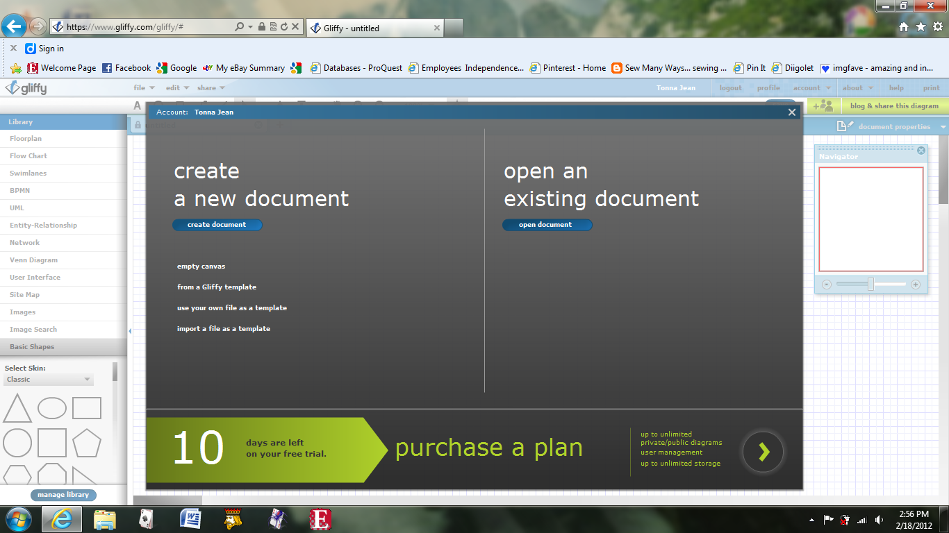
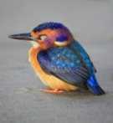

Slide 4
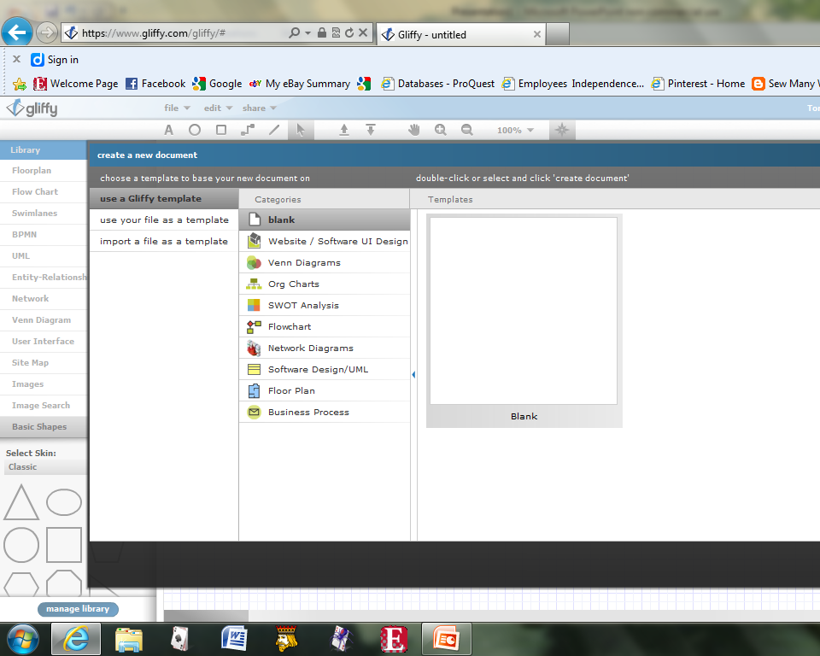
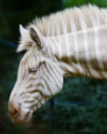

Slide 5
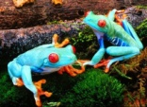

Slide 6
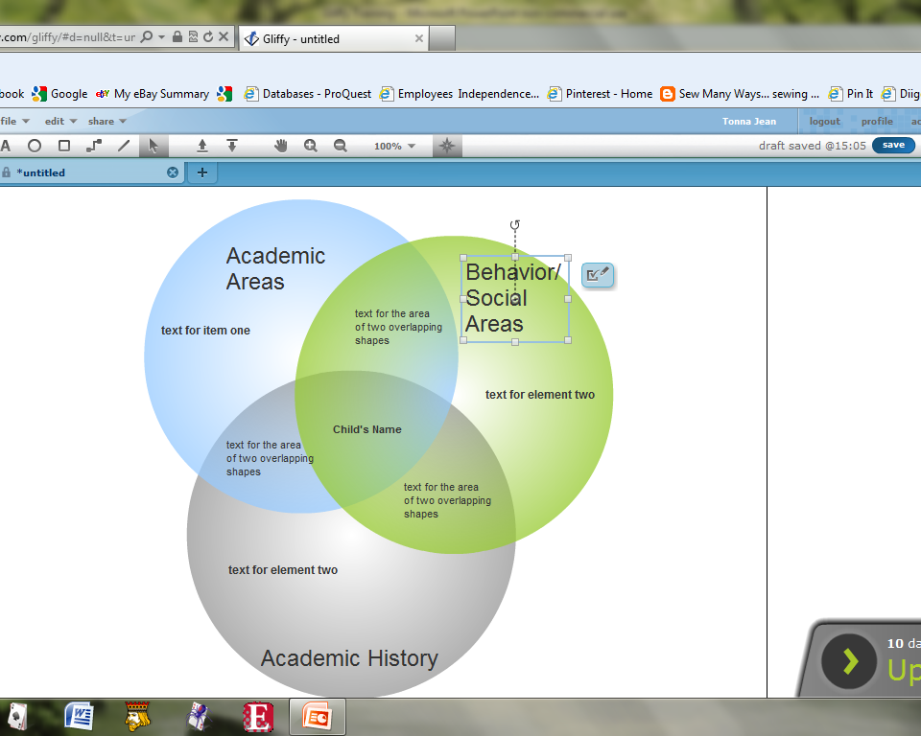
Editing tool for all elements.

Slide 7
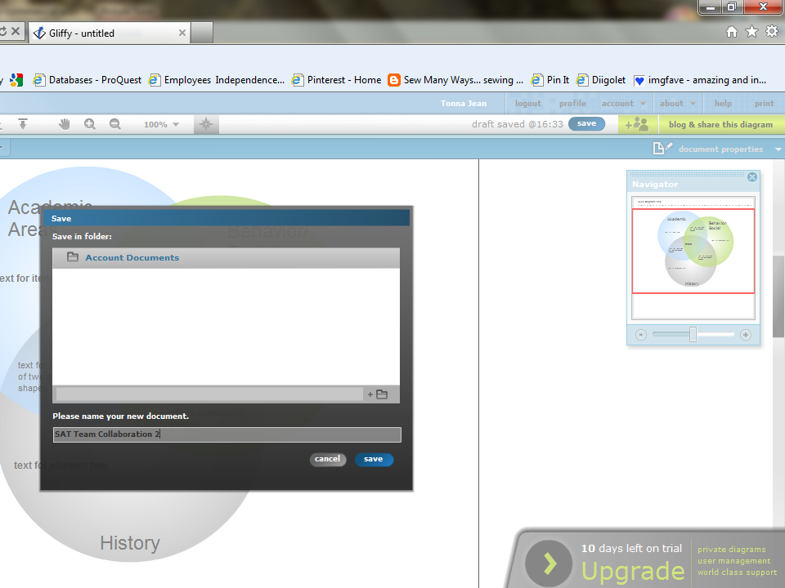
Save button
Saves to Account Documents in Gliffy.

Slide 8
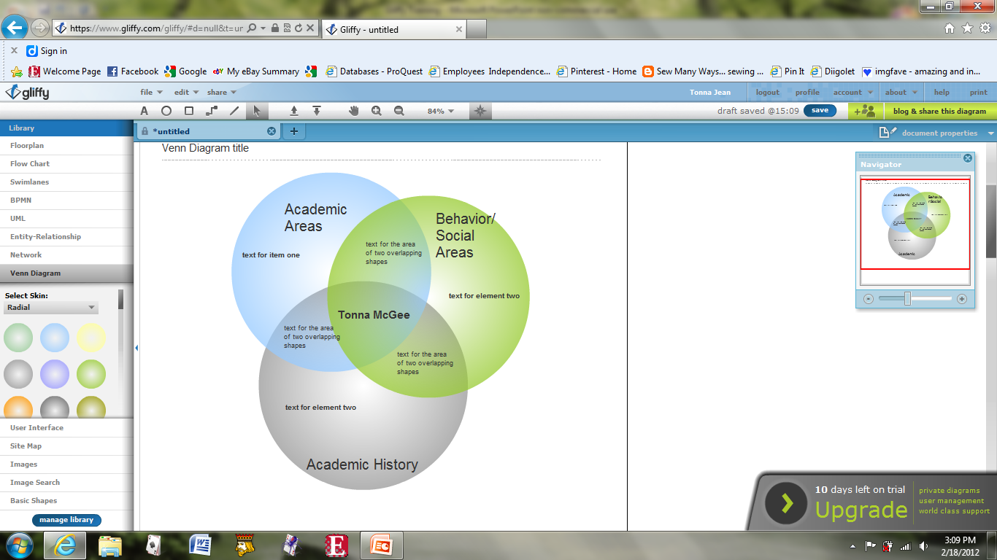
Share the diagram.

Slide 9
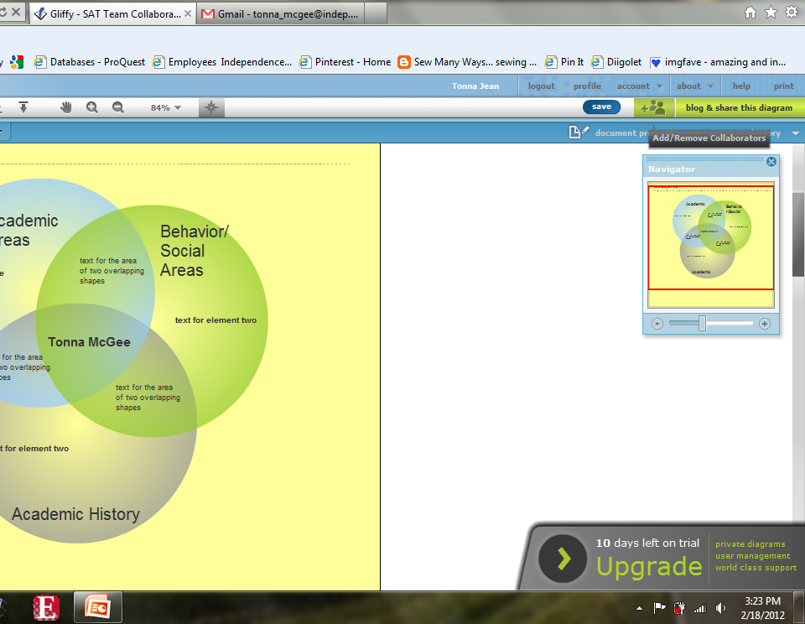
Add or Remove Collaborators

Slide 10
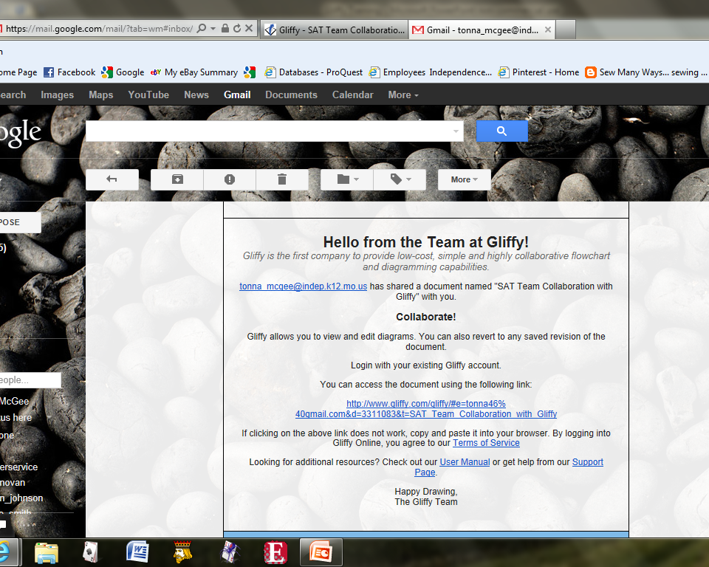

Slide 11
A Few Gliffy Potential Uses
Grade level collaboration
Special committee meetings across school district
Resource sharing across grade levels or school district
Student collaboration work

Slide 12
References
www.gliffy.com

